Slide 1

Reinforcement Learning
FYP – Resourceful Robots – Cougar Tasker - 100927777
Notes:
Hello everyone, I’m Cougar, and my project is about implementing reinforcement learning.

Slide 2
Outline
Reinforcement Learning Background
What is Reinforcement Learning?
My project:
Its current state
Its future
Conclusions

Slide 3

Reinforcement Learning Background
Machine Learning paradigm
Wide reaching with relevance to Optimal control theory and Operant conditioning
Applications such as:
Self-driving cars: Wayve.ai
Medicine: ReLeaSE
Gaming: AlphaGo Zero
Robotics…
And Many More
Notes:
Reinforcement learning is one of the main paradigms of Machine learning,
Its an exctiting area of research
It encompasses a class of problems, wide number of solutions that work well with it
Its core thoery but its core is widley applicable to problems such as
You may have heard of other paradigms like supervised and unsupervised learning, they seem to exhaustively classify machine learning paradigms, however reinforment learning is a paradigm in its own right
Reinfomrent learning

Slide 4

What is Reinforcement Learning?
Delayed Reward Driven Agents
Discounted Cumulative Reward
Markov Decision processes
Policy
Bellman Equations
Exploration vs Exploitation
Notes:
Reinforcement learning is different from other kinds of learning because:
not needing labelled input/output
of its delayed reward.
Having a goal cumulative reward drives its actions its unlike unsupervised learning -> not uncovering parterns and structures in the the underlying data just trying to exploit it

Slide 5
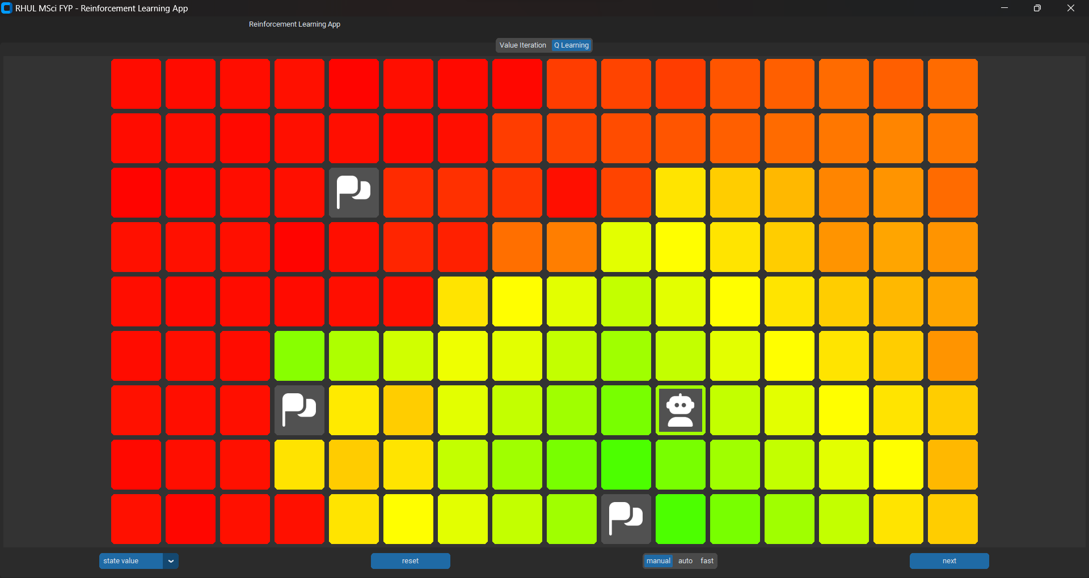
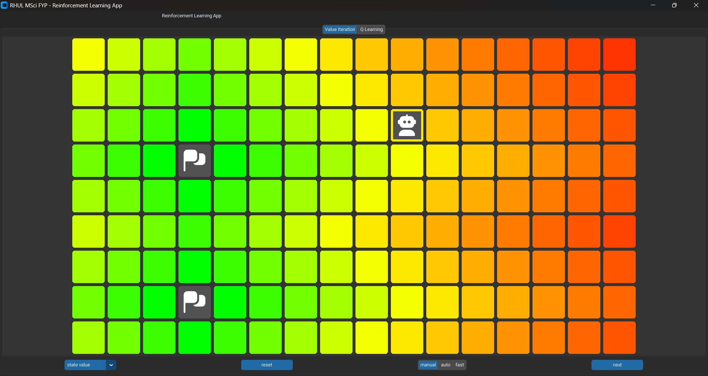
My Project: Resourceful Robots
Grid World Environment
Two Agents:
Value Iteration
Q-learning (with n-step lookahead)
Notes:
The goals of my project is to implement

Slide 6
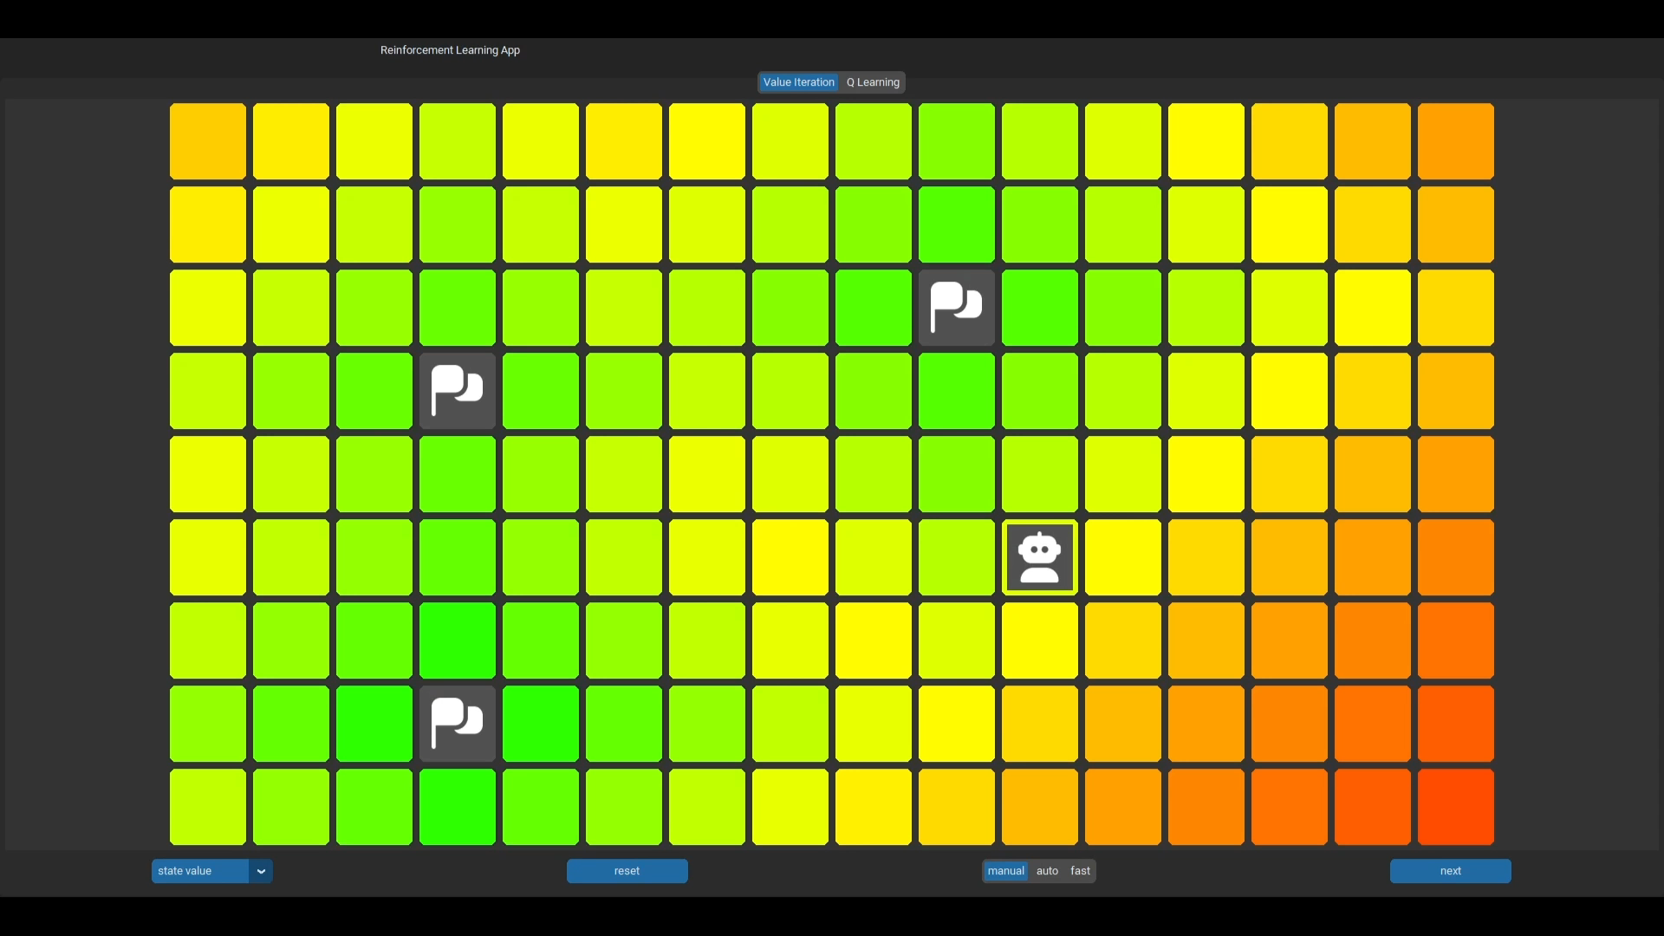
Value Iteration Agent

Slide 7
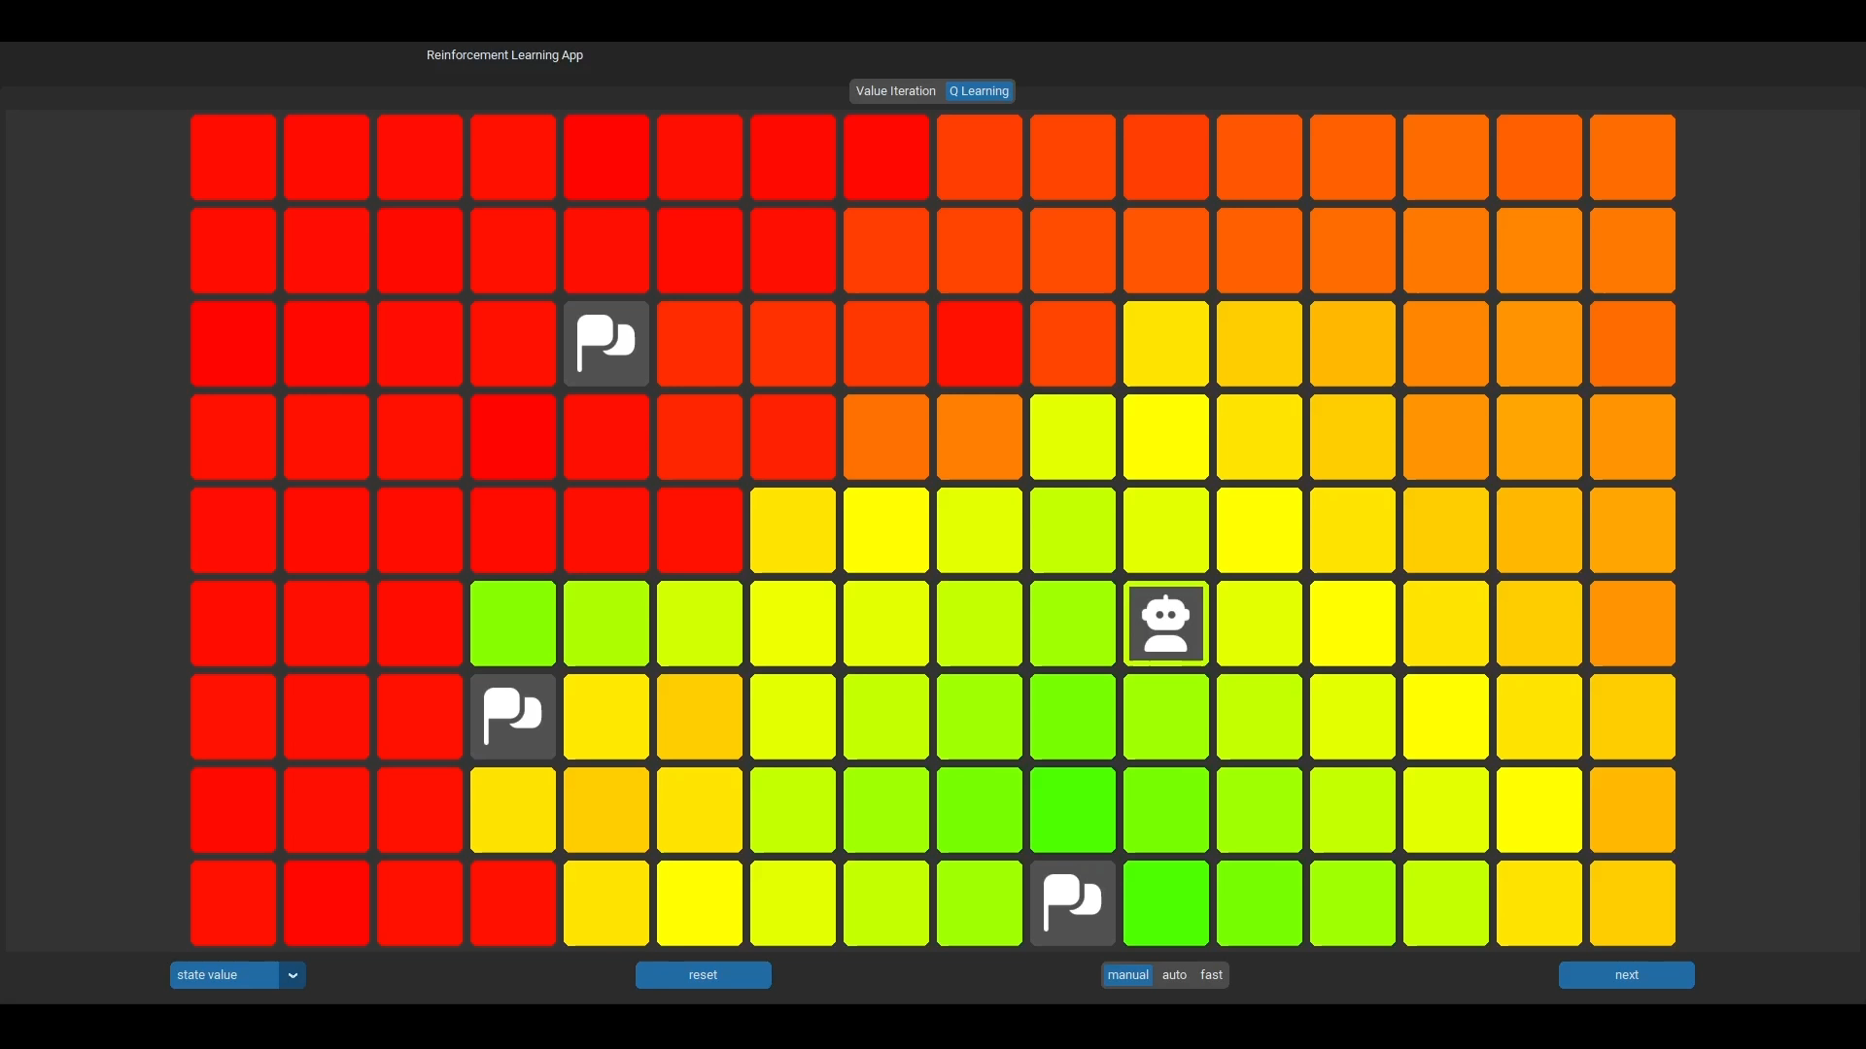
Q-Learning Agent

Slide 8
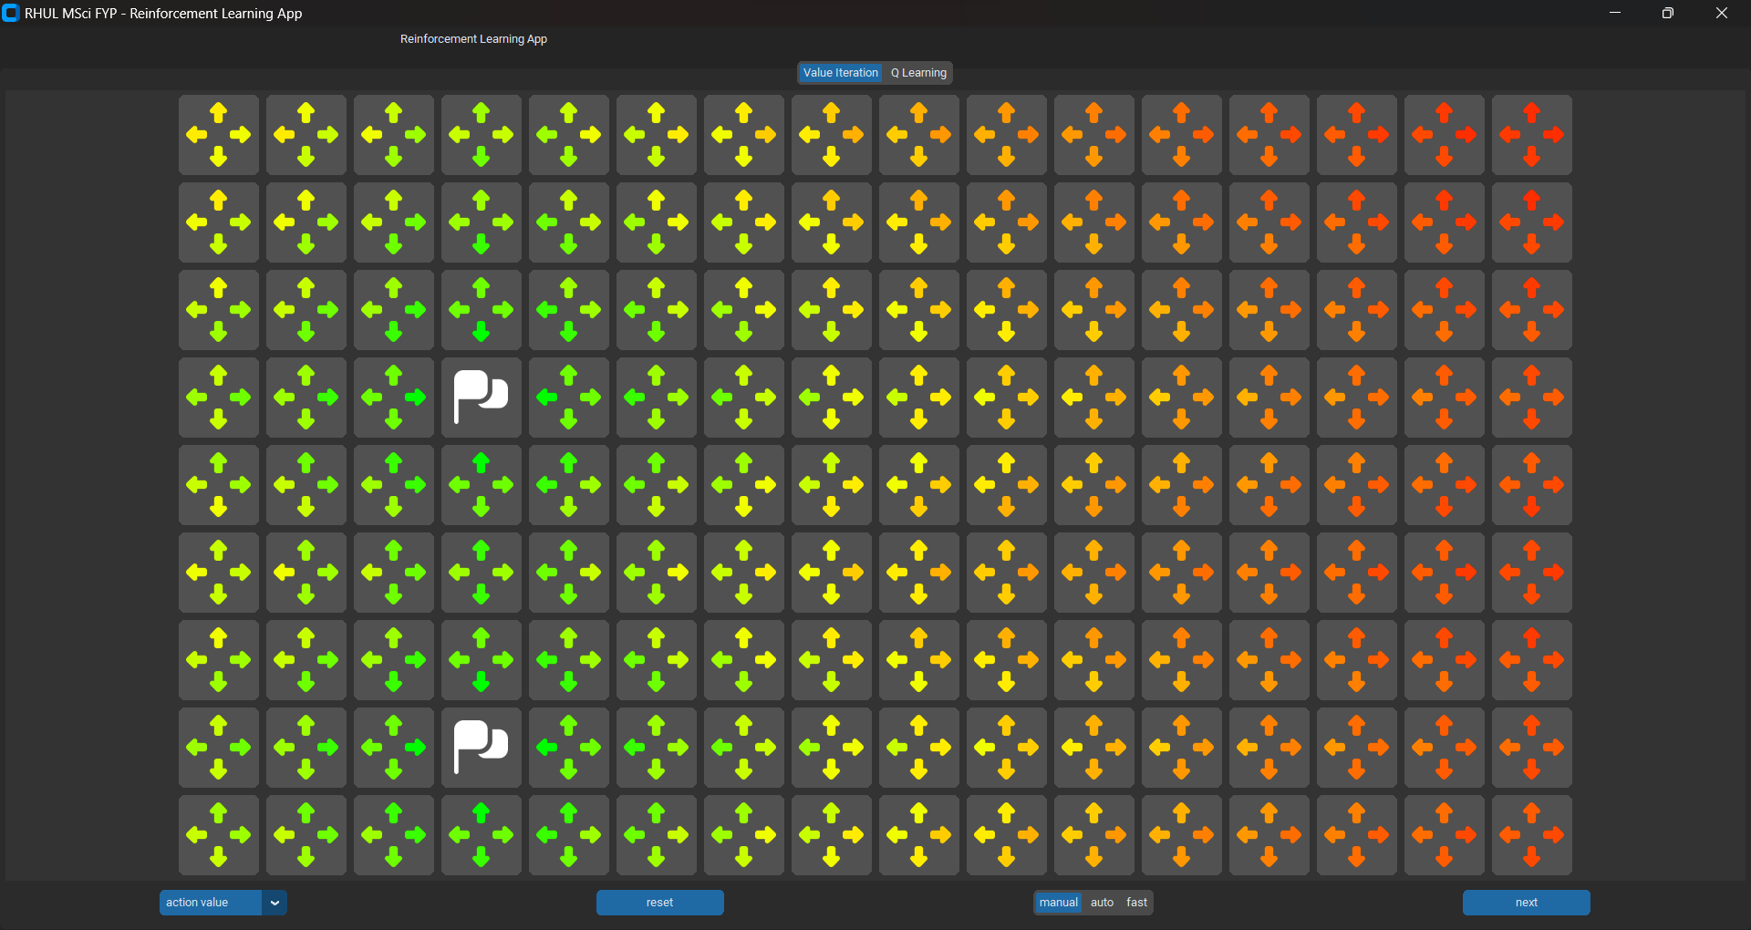
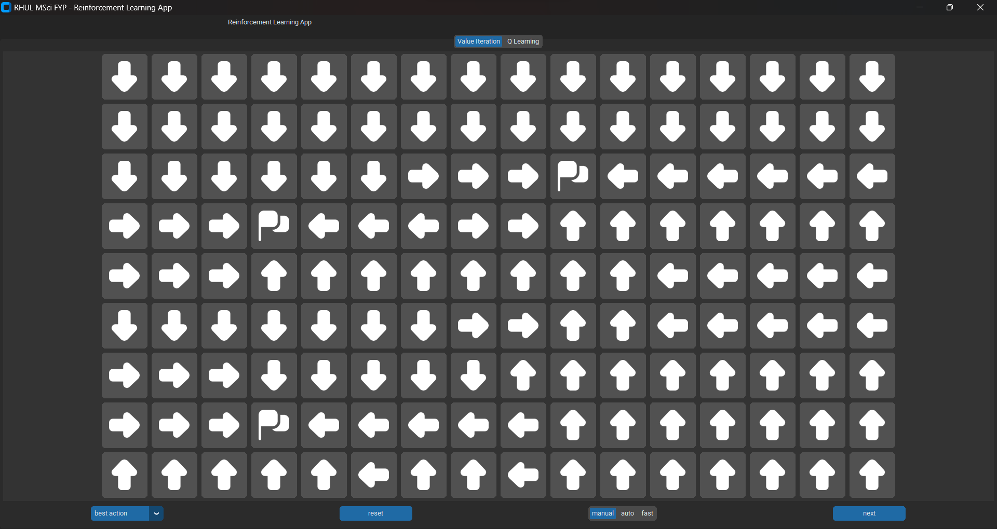
Q-value Table

Slide 9
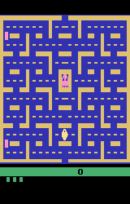
Looking Forwards
Different exploration strategies
Deep Q-learning
More Challenging Environments:
Resource Trade-offs
Gymnasium
Notes:
Other Strats: upper confidence bound, epsilon soft, softmax, pursuit
Resource Trade-offs such as managing battery levels

Slide 10

Conclusions
Reinforcement learning is incredible:
It doesn’t require a training set and can learn from its mistakes
Can achieve optimal behaviour
However:
It requires tuning
It can be costly in data and computation
Questions
Notes:
the curse of dimensionality

